Slide 1
Predictive Maintenance Web App
Web Dev Intern : Project Workflow Presentation

Slide 2
Project overview
GOAL : Predict machinery faults using CNN and vibration data.
Users upload vibration spectrograms to receive predictions.
Frontend and backend built using Flask, HTML, CSS, and Python.
Deep learning handled by a separate DL module.
Automation Testing done using PyAutoGui

Slide 3
My role : web dev intern
Built the frontend with HTML, CSS, and Jinja templates.
Integrated Flask backend with DL model (sample_predictor.py).
Created upload forms, result views, metrics dashboard.
1
Front end - Interface for File Upload and instructions to start over
2
Backend to handle requests and run the DL model
3
Display the generated results , model metrics.

Slide 4
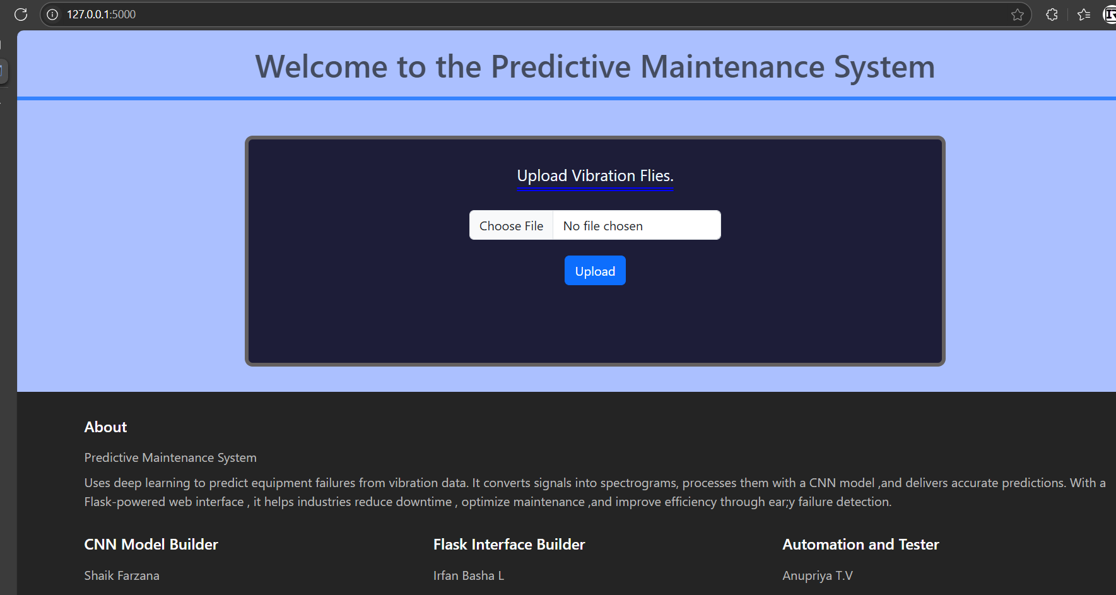
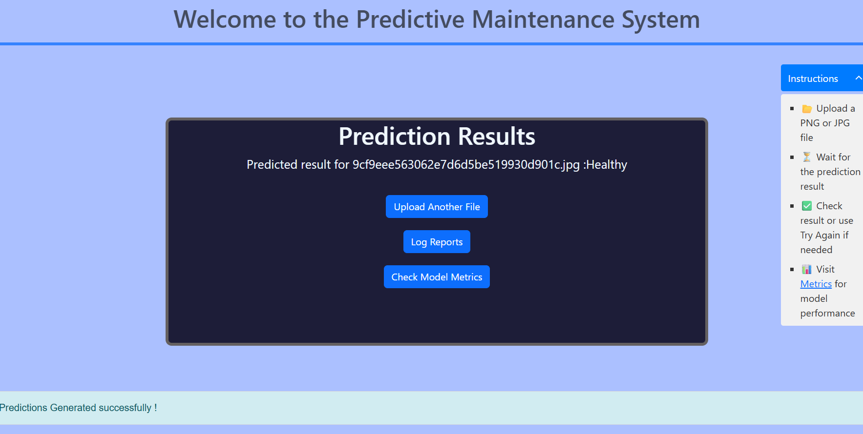
Web interface snapshots

Slide 5
New Things I Learnt and Implemented
Flask routing
Form handling
Template inheritance
Flash messaging
Spinner animation using JavaScript
Built a ‘/metrics’ route and displayed ‘sample_metrics.json’ file

Slide 6
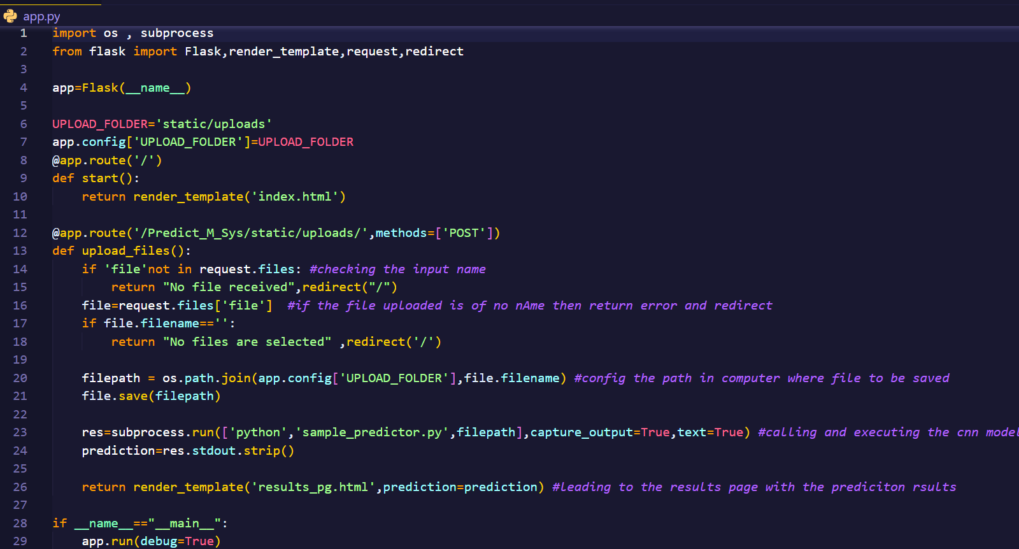
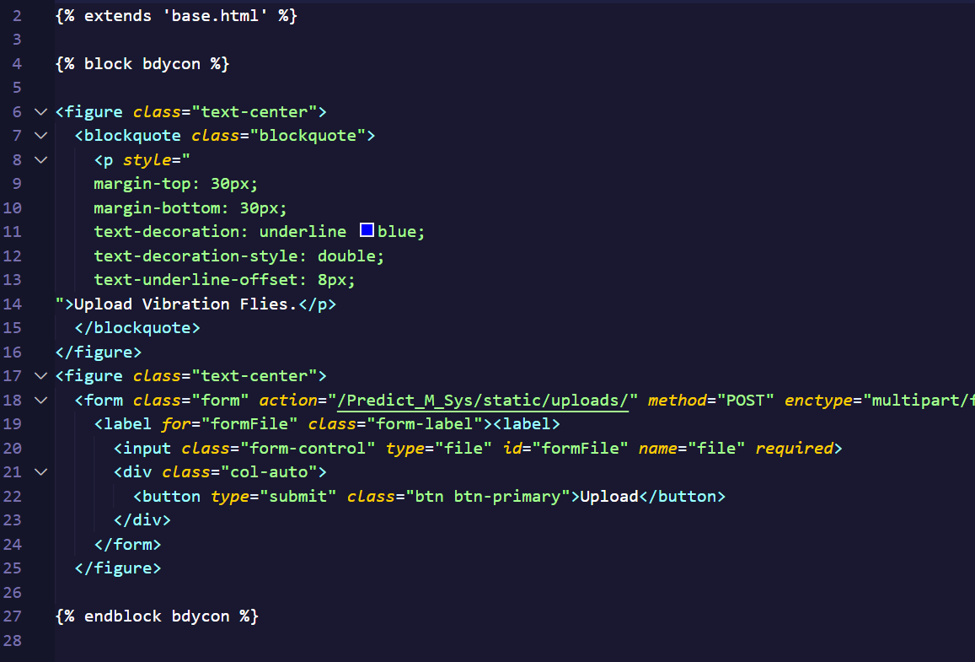
Code snippets

Slide 7
Thank you
IRFAN BASHA L
8431153730 | ir.358.786@gmail.com

